Slide 1


Undergraduate Student Research Award
USRA
Summer 2026 Competition

Slide 2
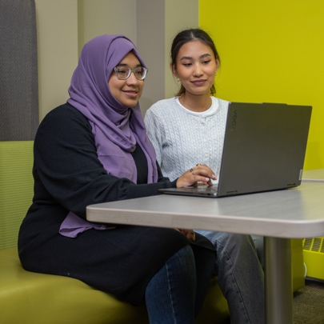
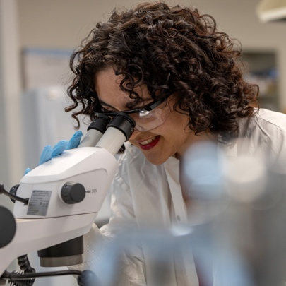

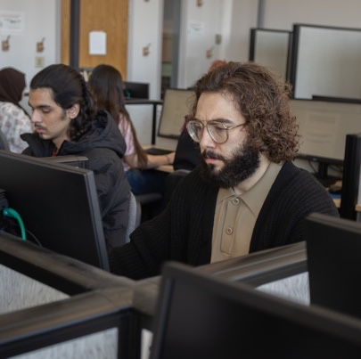
What is an USRA?
The Undergraduate Student Research Award enables students to work full-time with a faculty member to gain research work experience.

Slide 3
Value of the Award
$9,000 stipend (less 13% mandatory employer related costs)
Duration of the Award
Full-time employment (37.5 hours per week) over 14 weeks in the summer (May 4 – August 11, 2026)

Slide 4
CUE’s allocation is 5 awards
Plus+
NSERC USRA for undergraduate self-identified Indigenous scholar(s)
  For projects in the natural or physical sciences.
  Unlimited awards
NSERC USRA for undergraduate self-identified Black scholar
  For projects in the natural or physical sciences.
  1 award
SSHRC USRA for undergraduate self-identified Black scholar
  For projects in social sciences or humanities.
  1 award

Slide 5
Eligibility
To be eligible for an USRA, you must:
be a Canadian citizen or permanent resident of Canada;
be registered in a full-time course load in a bachelor’s degree program at the time you apply;
be in good academic standing the year of application (i.e., not be on academic probation). Have obtained over the previous years of study, a cumulative average of at least a “B”;
have not held more than three USRAs throughout your university career.

Slide 6




How to apply for an usra
Read the program description and eligibility requirements.
Identify a faculty supervisor and confirm their willingness to supervise you.
Complete Concordia’s USRA application form.
Login to the NSERC online system and complete Part 1 of Form 202.
Give your reference number to your supervisor who will complete Part 2 of Form 202.

Slide 7
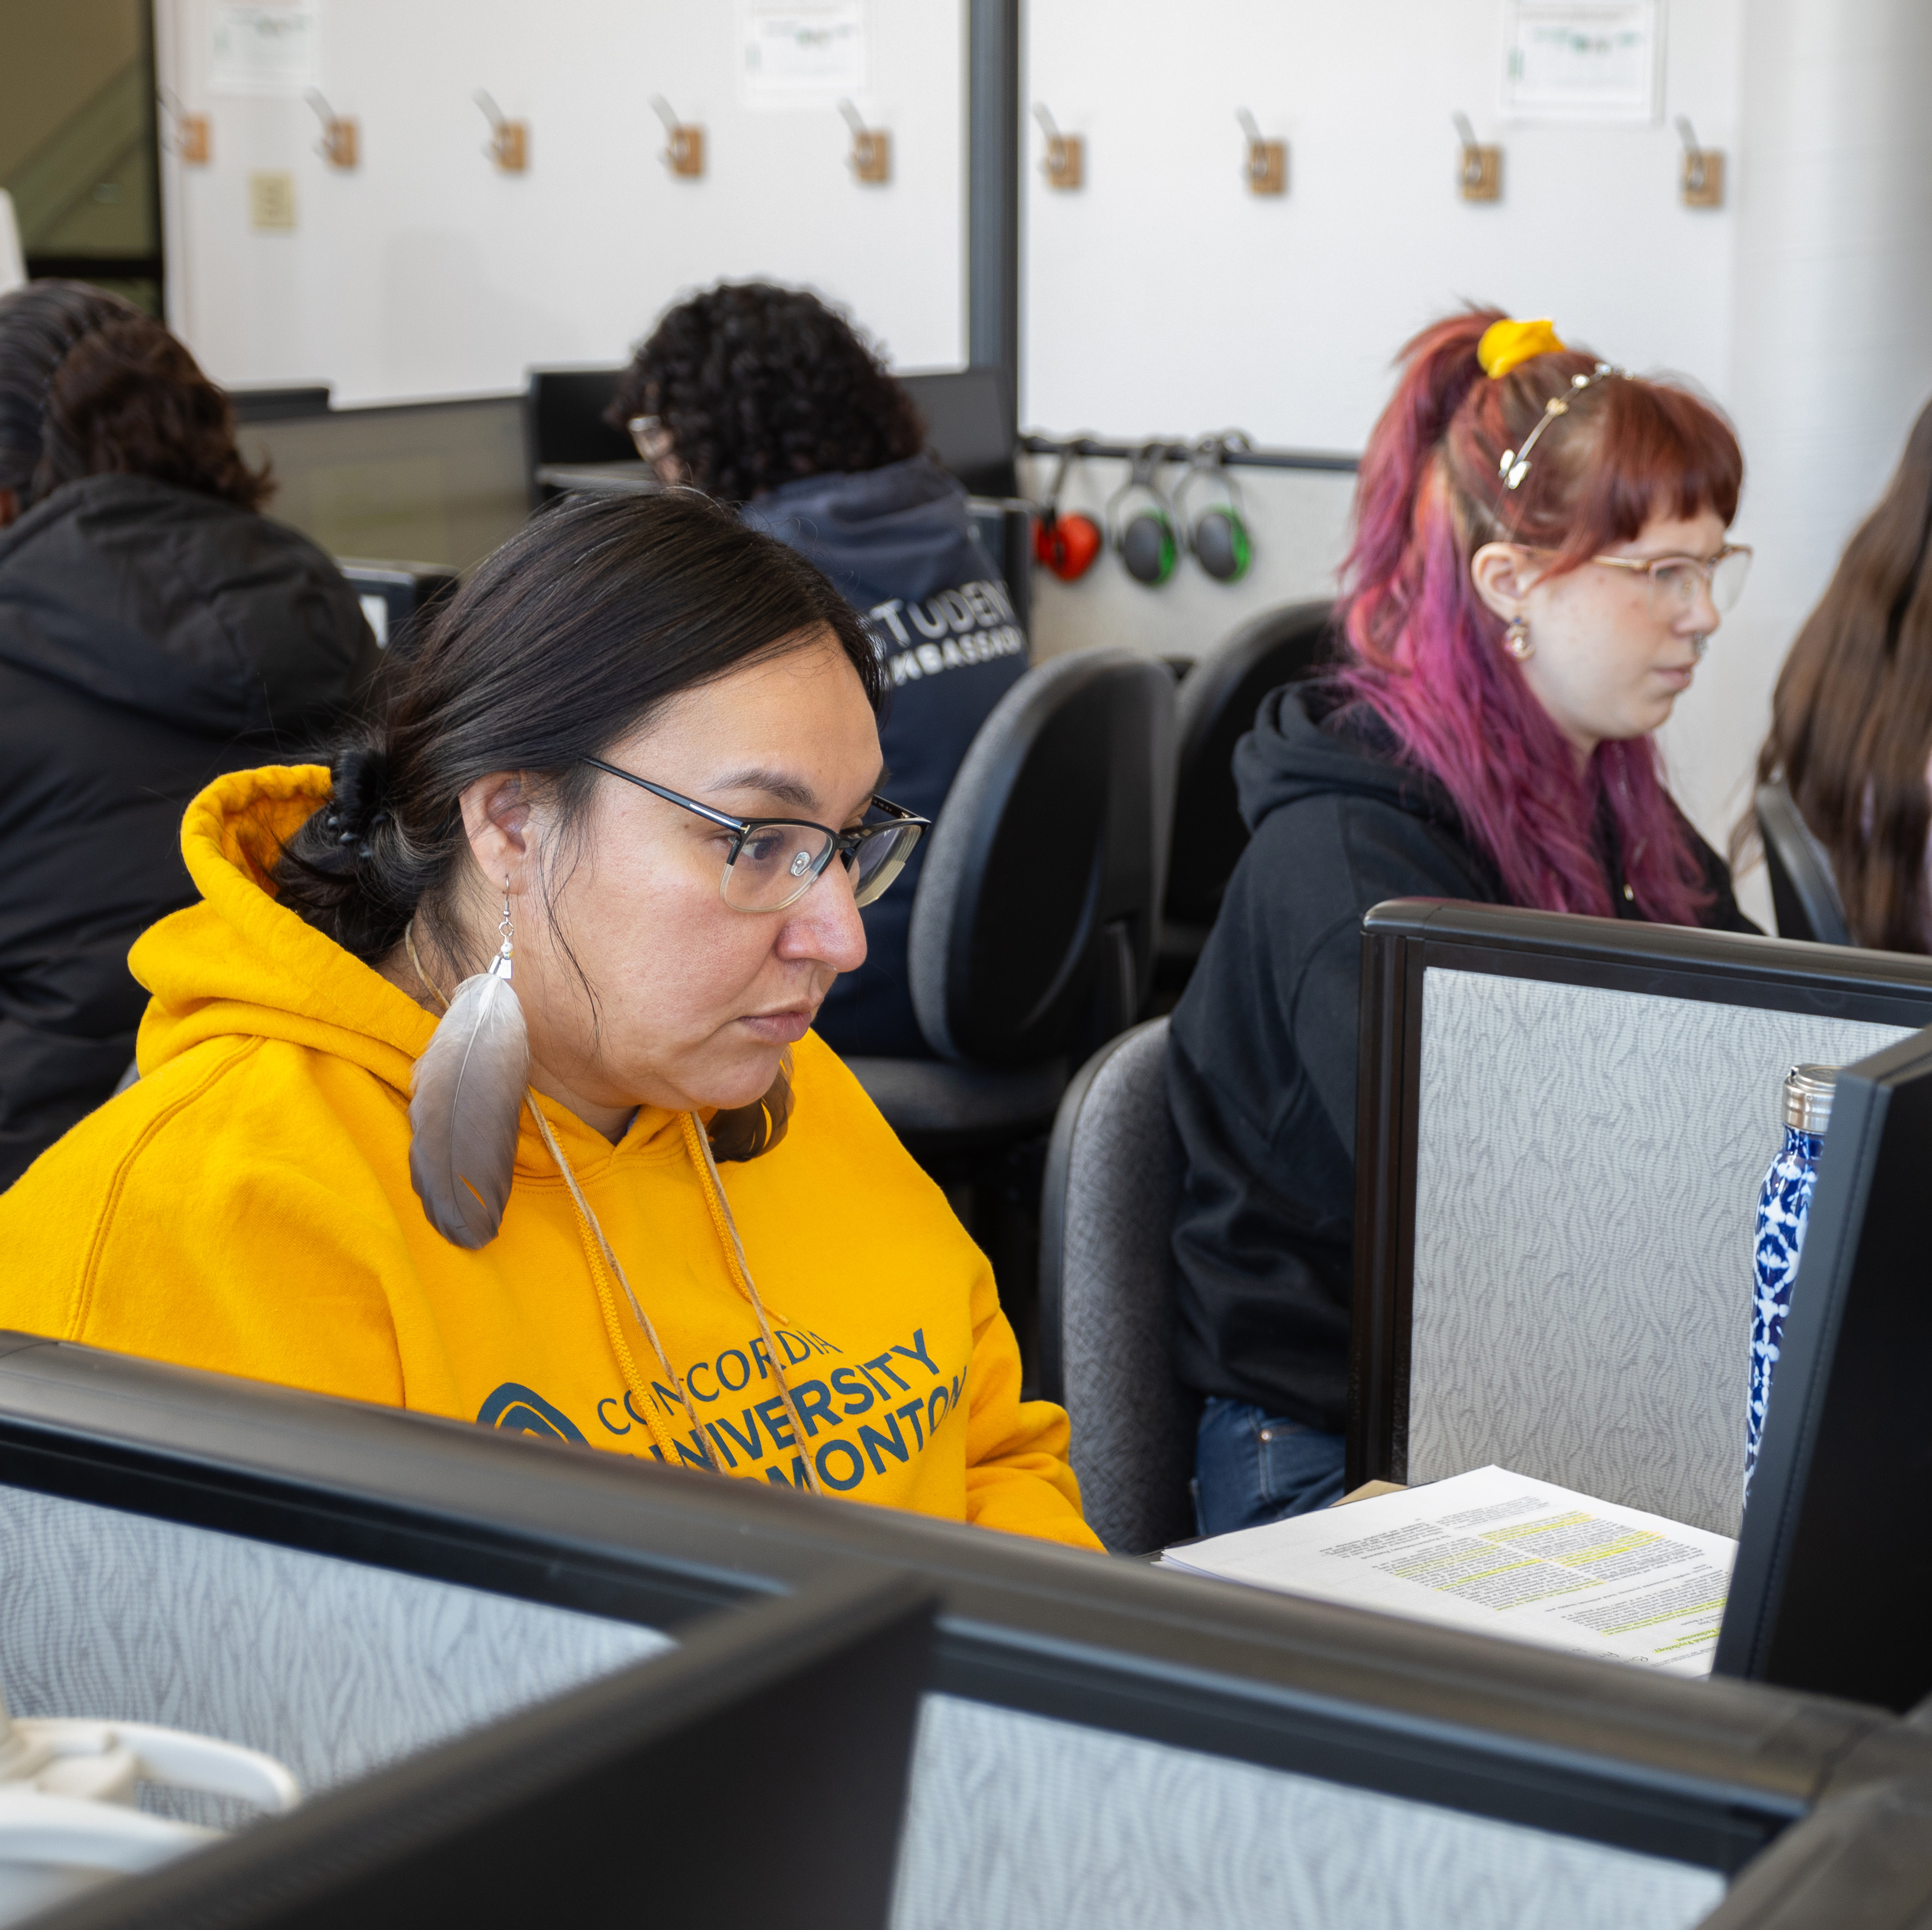
TIMELINE
Application Deadline: February 1
February: Committee Review & Selection
March: Notification of Results and Offers of Employment
May 4: USRA work period begins

Slide 8
supervisors
Supervisors must be full-time CUE faculty and authorized to independently supervise students by the institution (per terms of their appointment within their relevant Faculty).
It is preferred that the proposed supervisor hold an active research grant (as principal investigator or co-investigator) to provide the top-up requirement.
A faculty member can be the proposed supervisor for more than one applicant, to a maximum of two USRA recipients.
Student require a faculty member to mentor and supervise them and the research project. Students are to be integrating a research project within their supervisor’s research program.

Slide 9
August 19, 2026
Summer Research Day is an all-day event to showcase the impactful research that takes place over the summer at CUE.

Slide 10
Why should You apply for an USRA?
You are an undergraduate student with a curious mind.
You are interested in doing research.
You have an interest in pursuing graduate studies.
You are interested in a career in a research area.
You want to develop career-ready skills and add it to your CV.

Slide 11
Where can I get more information?
Concordia’s Website:
https://concordia.ab.ca/scholarships/undergraduate-student-research-award-usra
NSERC Website:
https://nserc-crsng.canada.ca/
Talk to a Faculty Member about their research
Office of Research and Innovation
ori@concordia.ab.ca
Financial Aid and Awards Office
finaid@concordia.ab.ca OR 780-479-9219

Slide 12


QUESTIONS?

